Slide 1
SPACESHIP TITANIC PREDICTION

Slide 2
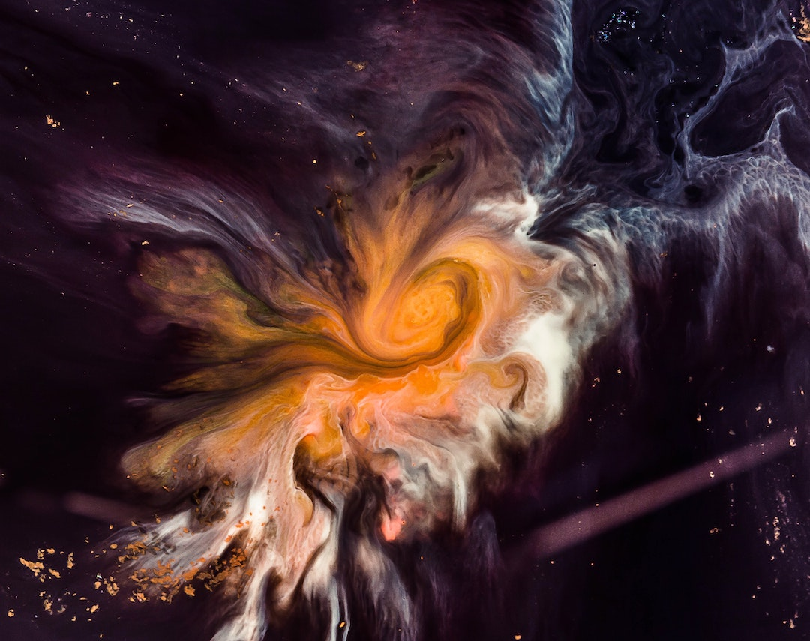
INTRODUCTION:
The event of occur – 2912
To solve a Cosmic mystery
Data – 4 lightyears away
It was an interstellar passenger liner launched a month ago(13000)
Collided with a spacetime anomaly hidden within a dust cloud.

Slide 3
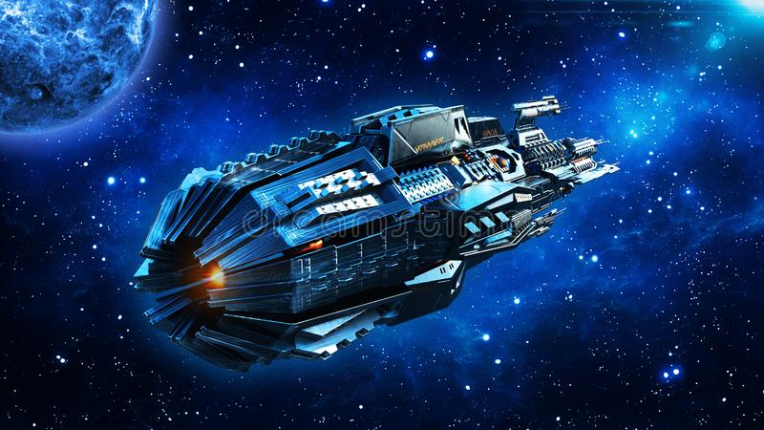
PROBLEM STATEMENT (Business level)
To help rescue crews and retrieve the lost passengers
Challenged to predict which passengers were transported by the anomaly
By using records recovered from the spaceship’s damaged computer system

Slide 4
PROBLEM STATEMNET
To predict whether a passenger was transported to an alternative dimension.
Objective: to build a model that could successfully determine whether a passenger transported or not

Slide 5
SOFTWARE REQUIRED
TOOLS USED
Google Colab- Notebook
LIBRART USED
Analyzing: Numpy, Pandas, Sci-kit Learn
Visualization: Matplotlib, Seaborn

Slide 6
WORKFLOW DIAGRAM
Preprocessing
Learning & evaluating
Machine learning Algorithm training
Train data
Data Preprocessing
Feature Extraction
Training data
Finalized Model
Spaceship Titanic Dataset
Val data
Data Preprocessing
Feature Extraction
Machine learning Algorithm evaluation
Preprocessing
Prediction on unseen data
Test data
Data Preprocessing
Feature Extraction
Finalized Model
Prediction unseen data

Slide 7
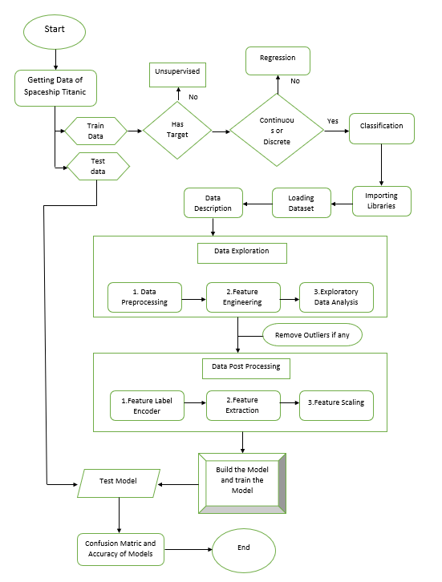

Slide 8
IMPLEMENTATION
Importing the necessary libraries
Importing the dataset
Cleaning and analyzing the dataset
Building the different model
Using the best model for making predition

Slide 9



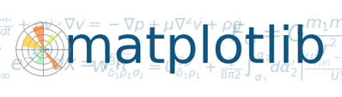

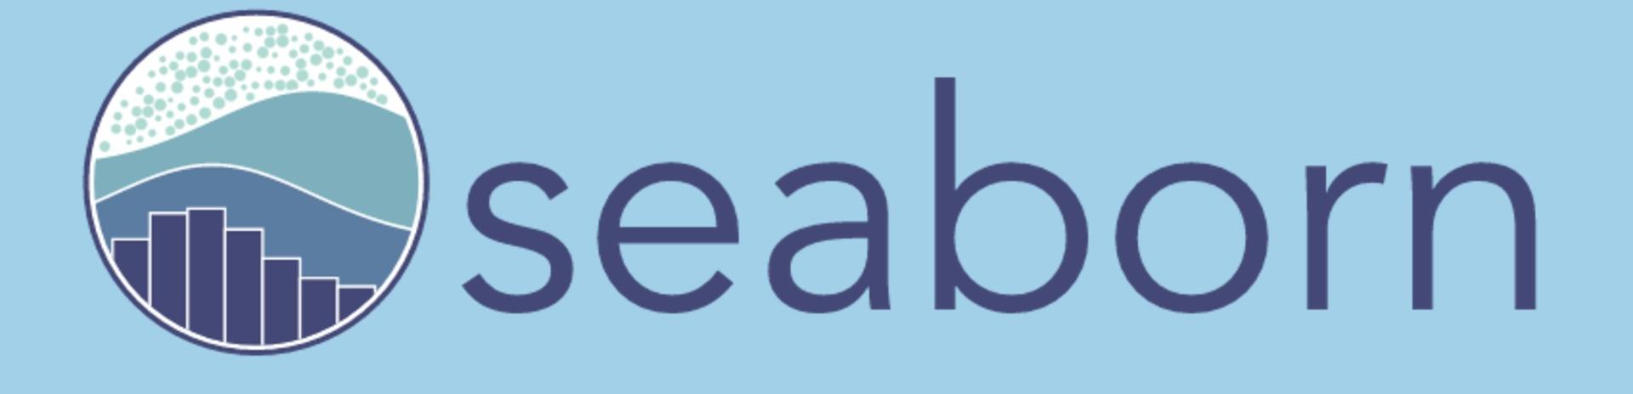
IMPORTING LIBRARIES:

Slide 10
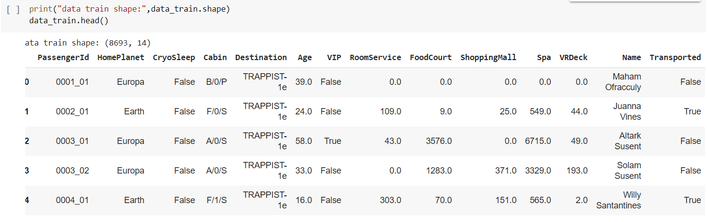
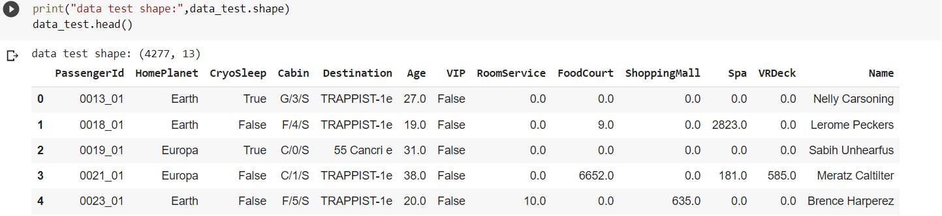
IMPORTING DATASET

Slide 11
DATA PREPROCESSING:
Checking the info of dataset
Handling missing values
Checking Duplicate values
Creating new features
PassengerId – Ingroup
VRDeck – Deck & side separated
We checked how many are billed and belongs to which age group

Slide 12
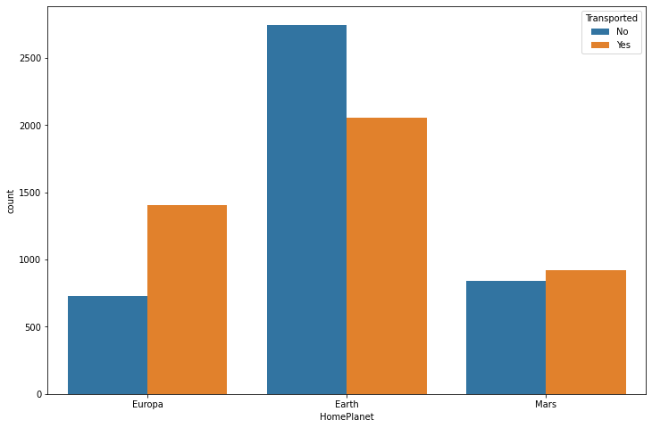
DATA VISUALIZATION:
How independent variable is affecting the Transportation ?
HOME PLANET

Slide 13
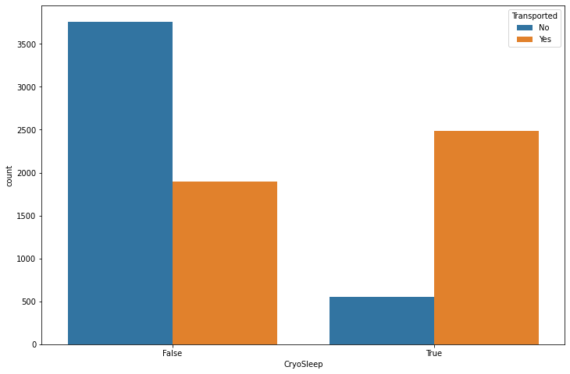
DATA VISUALIZATION
CRYOSLEEP

Slide 14
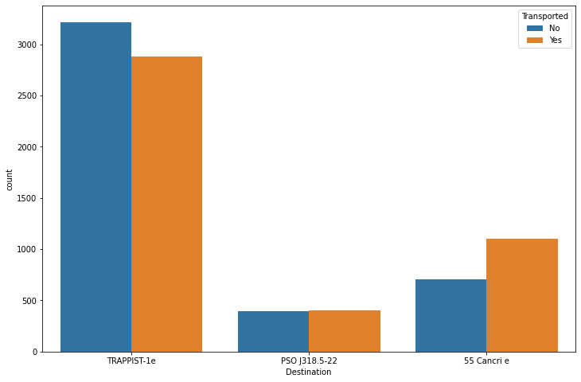
Data Visualization cont…
DESTINATION

Slide 15
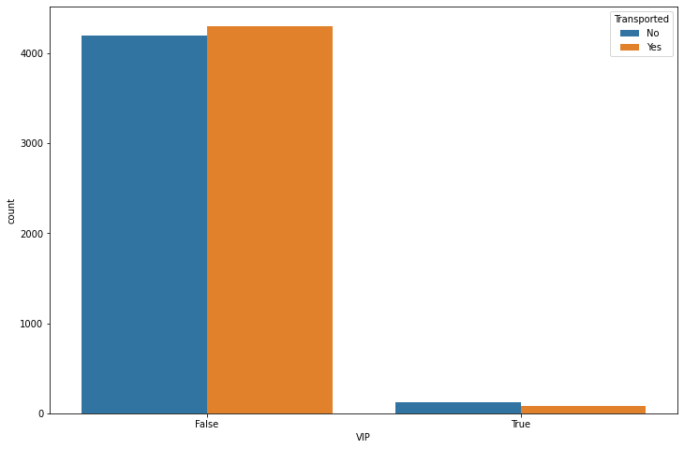
Data Visualization cont…
VIP

Slide 16
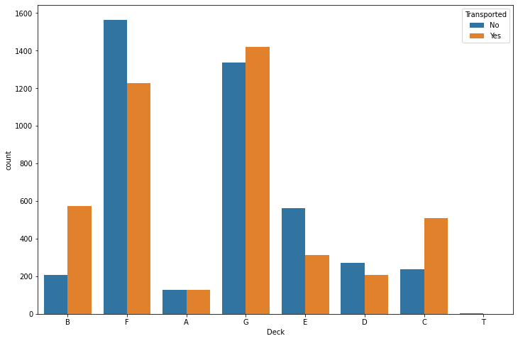
Data Visualization cont…
DECK

Slide 17
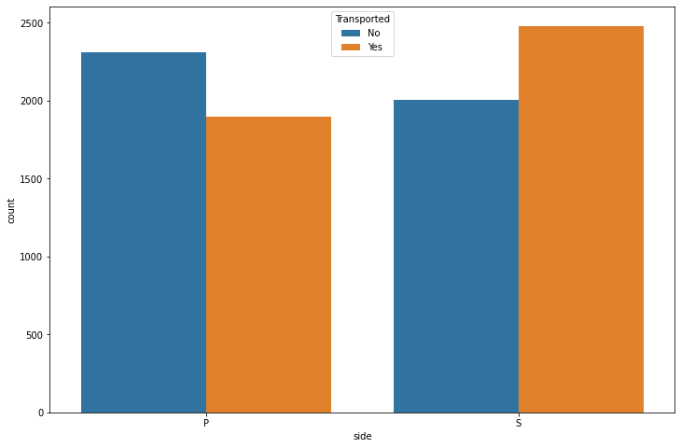
Data Visualization cont…
SIDE

Slide 18
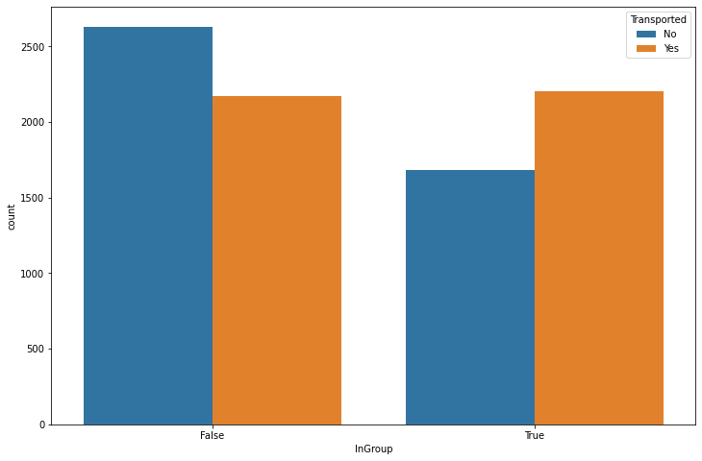
Data Visualization cont…
INGROUP

Slide 19
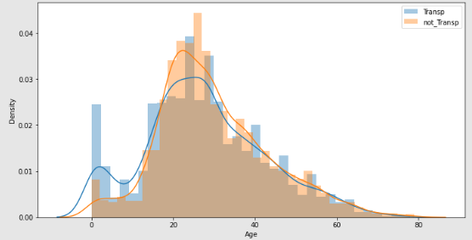
Data Visualization cont…

Slide 20
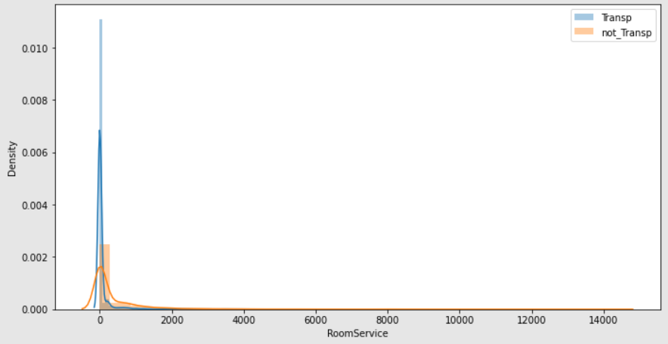
Data Visualization cont…

Slide 21
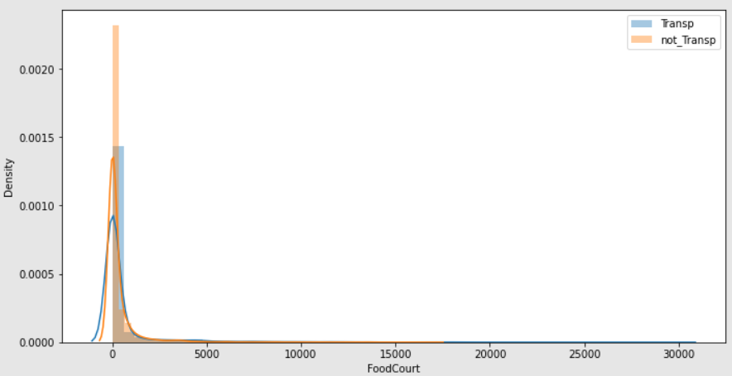
Data Visualization cont…

Slide 22
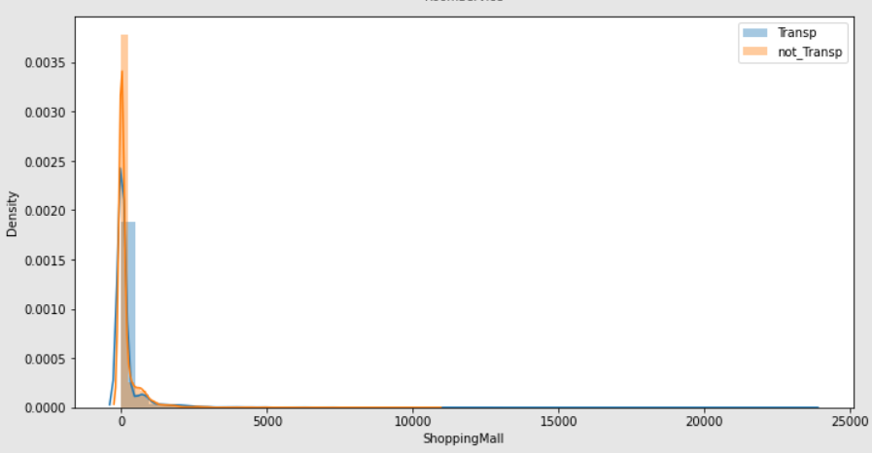
Data Visualization cont…

Slide 23
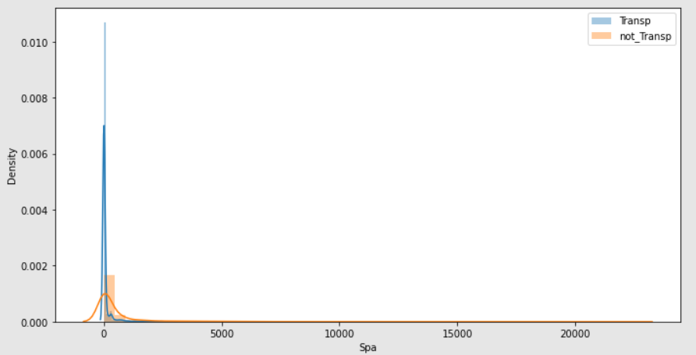
Data Visualization cont…

Slide 24
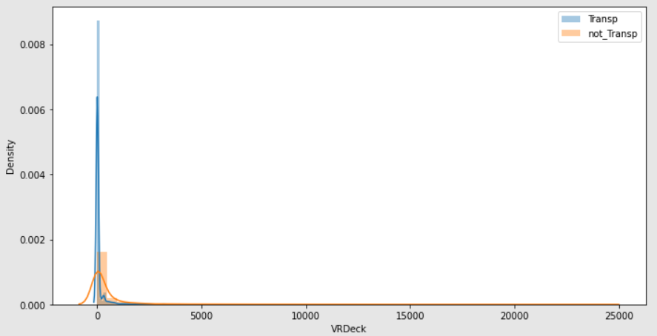
Data Visualization cont…

Slide 25
DATA POSTPROCESSING:
Removing Outliers
Feature Selection
Used Anova and Chi-square
PassengerId, Cabin, Name, GroupId ,GroupIdNumber, ShoppingMall
Feature Label encoder
Feature extraction
Dependent and independent
Train-test split
Feature Scaling

Slide 26
MODEL BUILDING:
Creating basic model
Train the model with train data
Evaluating the model with Val data
Tuning the model
Identify the best model
Predicting the result with Finalized model

Slide 27
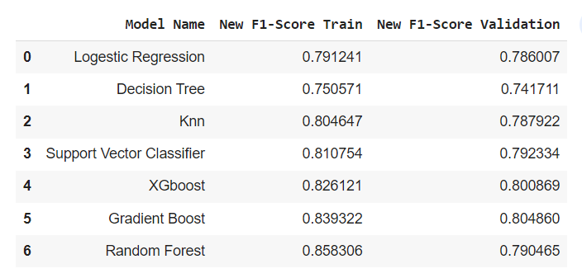
IDENTIFY THE BEST MODEL:

Slide 28
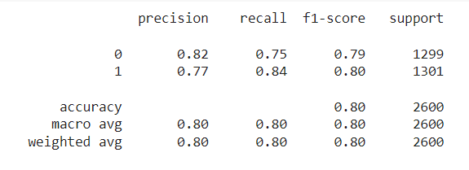
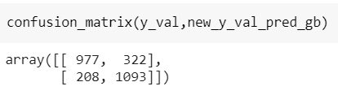
BEST MODEL CONFUSION MATRIX AND REPORT:

Slide 29
CONCULSION:
We started with the data exploration where we got a feeling for the dataset, checked about missing data and learned which features are important. During this process we used seaborn and matplotlib to do the visualizations. During the data preprocessing part, we computed missing values, converted features into numeric ones, grouped values into categories and created a few new features. Afterwards we started training 8 different machine learning models, and for each model we did hyperparameter tuning and checked with the confusion matric and with classification report which is consist of precision, recall and f-score picked one of them that is Gradient Boosting. But in this model is over fitted so to improve or to avoid this we can use any one of the methods which is mention in the future scope of improvements.

Slide 30
REFERENCE:
https://betterprogramming.pub/titanic-survival-prediction-using-machine-learning-4c5ff1e3fa16
https://www.geeksforgeeks.org/
https://www.javatpoint.com/

